Slide 1
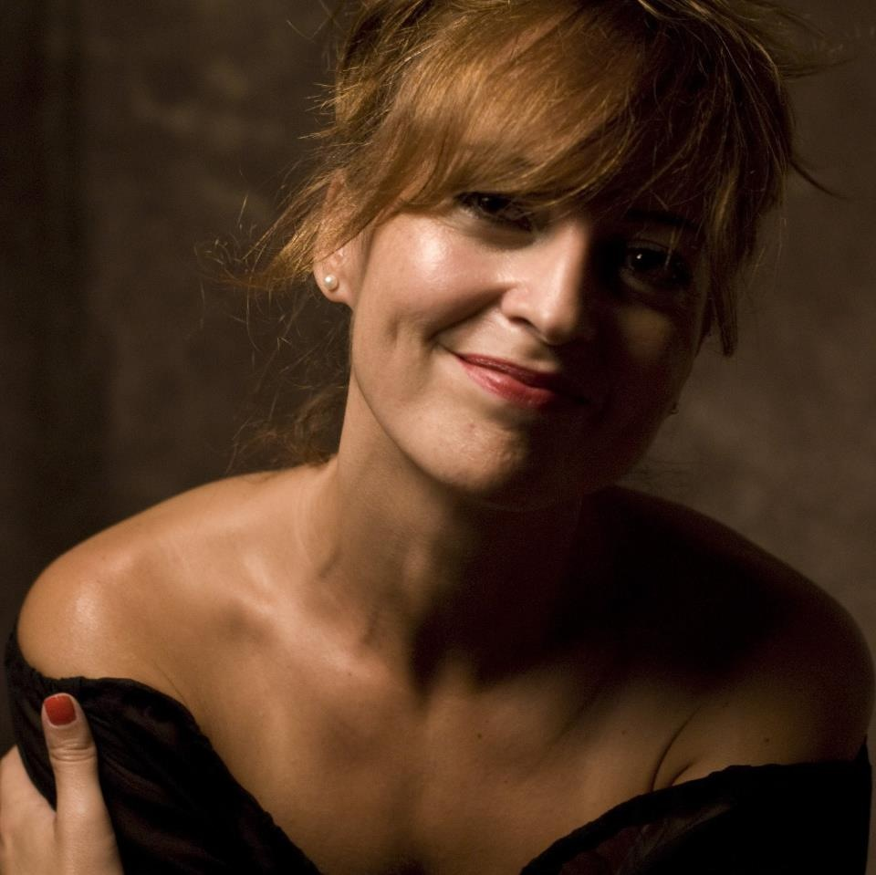
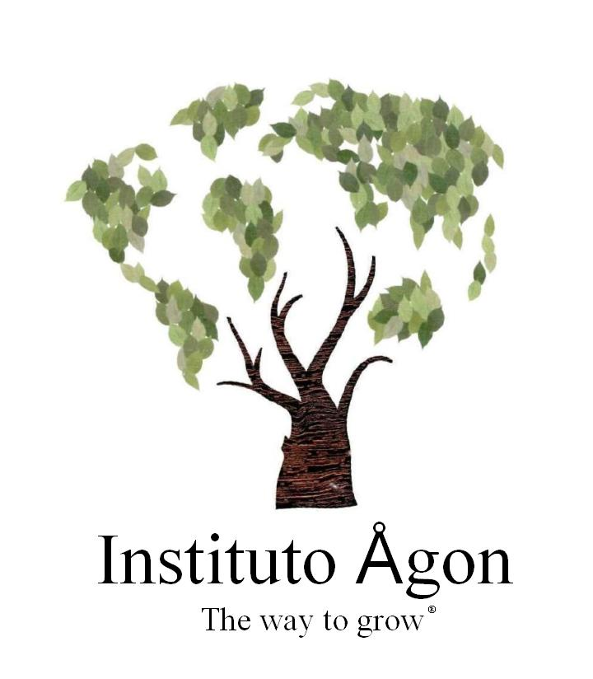

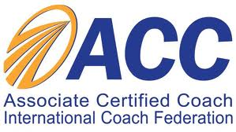


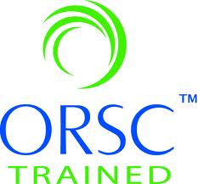

Bio
Specialist
Professional Co-active Coach Consultant on Leadership Development.
Mission
To promote greatness in human beings.
Biography
Clara Camacho is a Qualified Professional Coach trained on Leadership Development by The Coaches Training Institute, one of the most prestigious coaching schools of the world. Certified and associated to the International Coach Federation, Clara has recently founded the Instituto Ågon where she leads projects on human potential profit in the corporative world.
Her passion is empower people to overcome their inner limits and her experience as executive and team coach has lead her to be considered as a very powerful coach. Designer and facilitator of several programs of coaching abilities and leadership development, Clara is also speaker and author about personal development. Her next book is titled The Power of Compassion.
Some recent references are:
Laboratorios Almirall, Instituto de Coaching para el Deporte, Ajuntament de Barcelona, Universitat Ramon Llull, Ernst & Young.
Acreditations:
Clara Camacho
www.institutoagon.com
@_TheWayToGrow_

